Slide 1

Software Project Management
Dr. Sumaira Nazir
Department of Software Engineering
National University of Modern Languages, Islamabad

Slide 2
Project Communication Management

Slide 3
Project Communication Management
The goal of project communications management is to ensure timely and appropriate generation, collection, dissemination, storage, and disposition of project information.

Slide 4
Project Communication Management-Processes
Planning communications management involves
determining the information and communications needs of the stakeholders.
Who needs what information?
When will they need it?
How will the information be given to them?
The outputs of this process include
a communications management plan, project management plan updates, and project documents updates.

Slide 5
Project Communication Management-Processes
Managing communications involves creating, distributing, storing, retrieving, and disposing of project communications based on the communications management plan.
Outputs of this process are
project communications plan, project management plan updates, project documents updates, and organizational process assets updates.

Slide 6
Project Communication Management-Processes
Monitoring communications involves
ensuring that stakeholder communication needs are met.

Slide 7
Methods for Communicating
Formal
Informal

Slide 8
Formal and Informal Methods for Communicating
It is not enough for project team members to submit reports to their project managers and other stakeholders and then assume that everyone who needs to know the information will read the reports. Occasionally, that approach might work, but many people prefer informal communications. About half the general population are extroverts, so they enjoy talking to other people.

Slide 9
Formal and Informal Methods for Communicating
Many nontechnical professionals—from colleagues to managers—prefer to have a two-way conversation about a project rather than reading detailed reports, e-mails, or Web pages to try to find pertinent information

Slide 10
Formal and Informal Methods for Communicating
Many experts believe that the difference between good project managers and excellent project managers is their ability to nurture relationships and use empathic listening skills

Slide 11
Determining the Number of Communication Channels
Another important aspect of communications is the number of people involved in a project. As the number increases, the complexity of communication increases because there are more channels or pathways through which people can communicate.

Slide 12
Determining the Number of Communication Channels
Formula to determine the number of communication channels as the number of people involved in a project increases:
No of communication channel= n (n- 1) /2

Slide 13
Determining the Number of Communication Channels
Three people have three channels: (3(32 5 1))/2 3. Four people have six channels, five people have 10, and so on. Figure 10-2 illustrates this concept. You can see that as the number of people increases above three, the number of communication channels increases rapidly. Project managers should try to limit the size of teams or subteams to avoid making communications too complex. For example, if three people are working together on a particular project task, they have three communication channels. If you added two more people to their team, you would have 10 communication channels, an increase of seven. If you added three more people instead of two, you’d have 12 communication channels. You can see how quickly communication becomes more complex as you increase team size

Slide 14
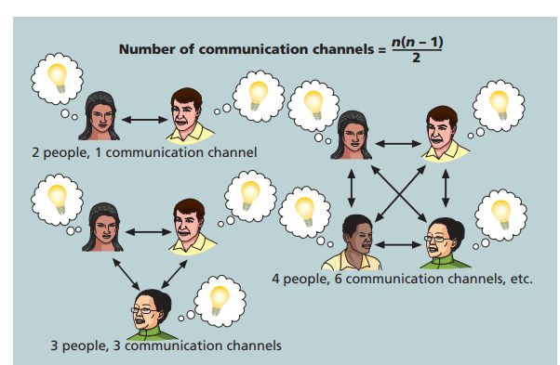

Slide 15
Planning Communications Managemen
Because communication is so important on projects, every project should include a communications management plan—a document that guides project communications. This plan should be part of the overall project management plan

Slide 16
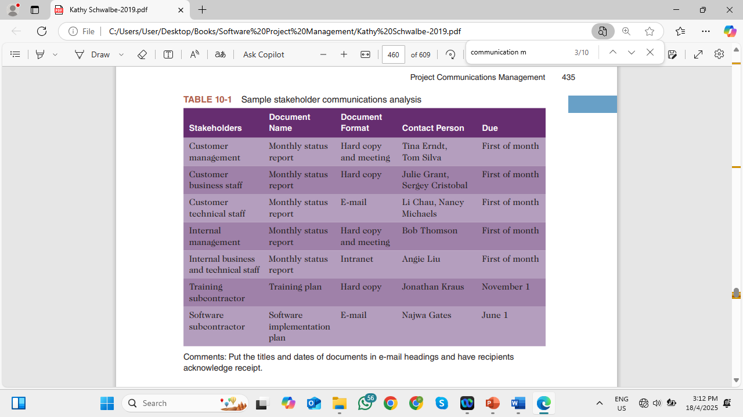
Sample stakeholder communications analysis

Slide 17
Classifications for communication methods:
There are three broad classifications for communication methods:
Interactive communication:
Push communication:
Pull Communication

Slide 18
Classifications for communication methods:
Interactive communication:
As the name implies, two or more people interact to exchange information via meetings, phone calls, or video conferencing. This method is usually the most effective way to ensure common understanding.

Slide 19
Classifications for communication methods:
Push communication: Information is sent or pushed to recipients without their request via reports, e-mails, faxes, voice mails, and other means.

Slide 20
Classifications for communication methods:
Pull communication: Information is sent to recipients at their request via websites, bulletin boards, e-learning, knowledge repositories like blogs and wikis, and other means

